Slide 1
What is Sound?
The Science Behind

Slide 2
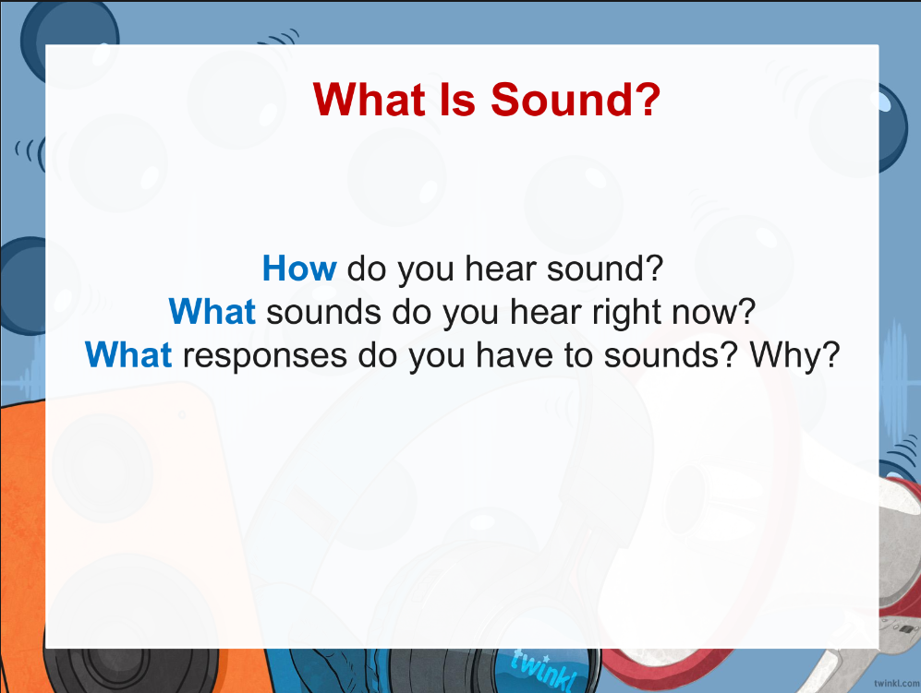

Slide 3
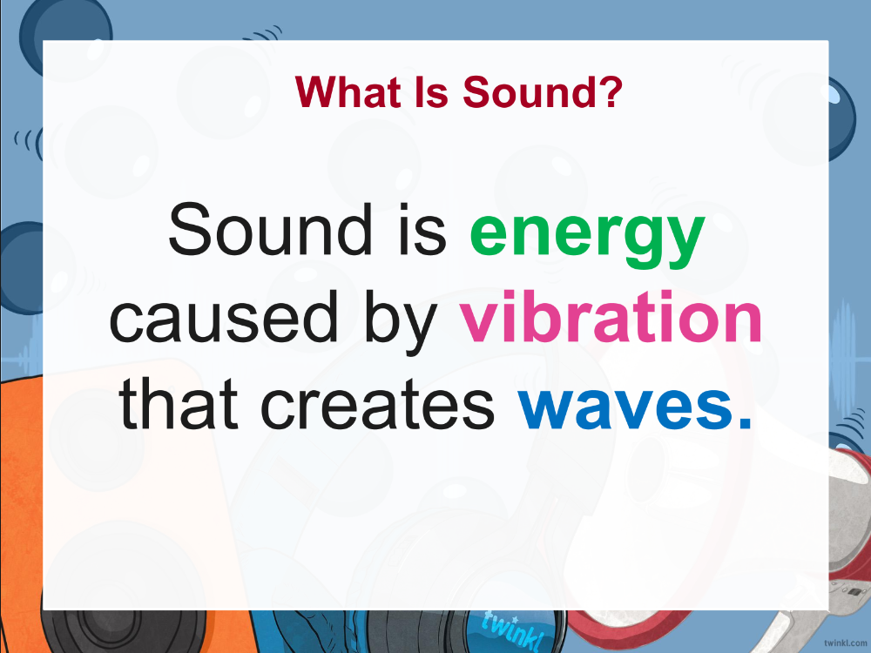
Title and Content Layout with Chart

Slide 4
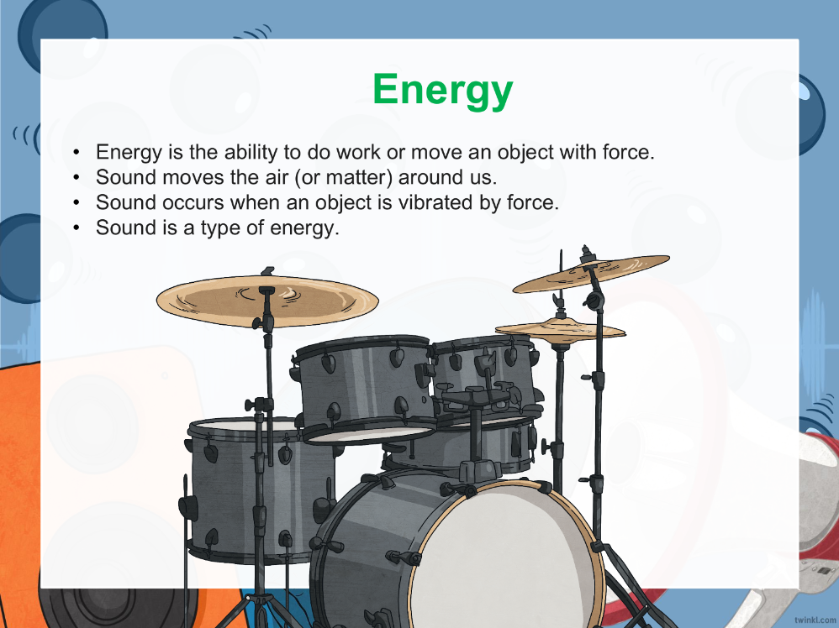
Two Content Layout with Table
First bullet point here
Second bullet point here
Third bullet point here
Class | Group 1 | Group 2
Class 1 | 82 | 95
Class 2 | 76 | 88
Class 3 | 84 | 90

Slide 5
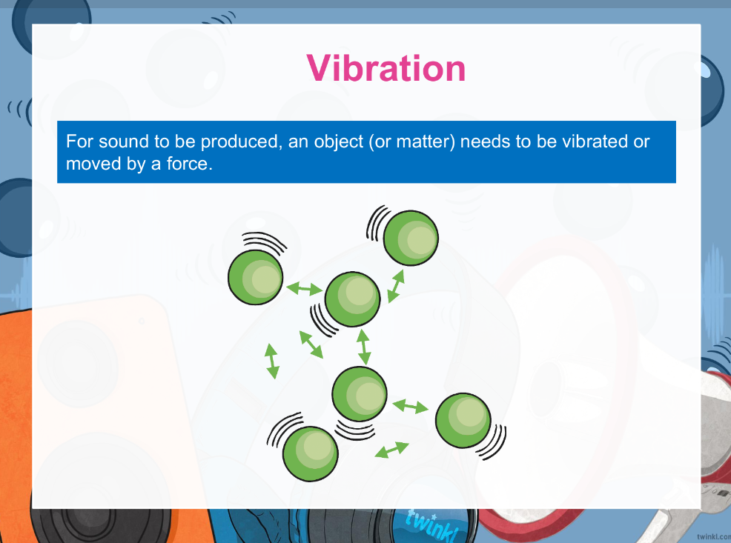
Title and Content Layout with SmartArt
Step 1 Title
Task description
Task description
Task description
Task description
Step 2 Title
Task description
Task description
Task description
Step 3 Title
Task description
Task description
Step 4 Title
Task description
Task description

Slide 6
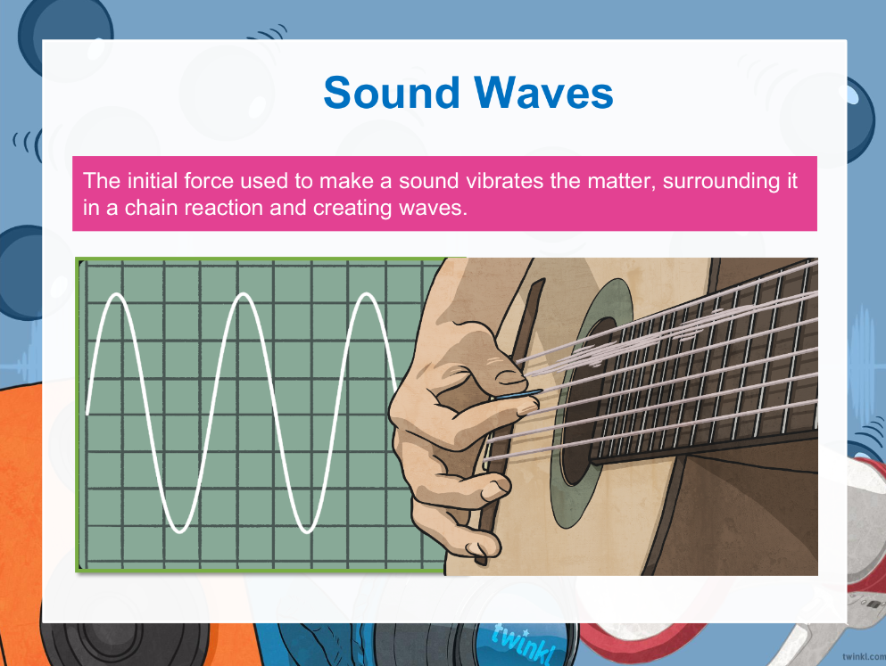
Add a Slide Title - 1

Slide 7
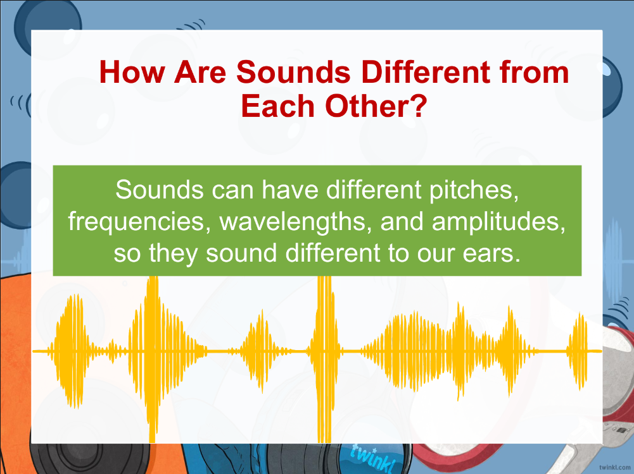
Add a Slide Title - 2

Slide 8
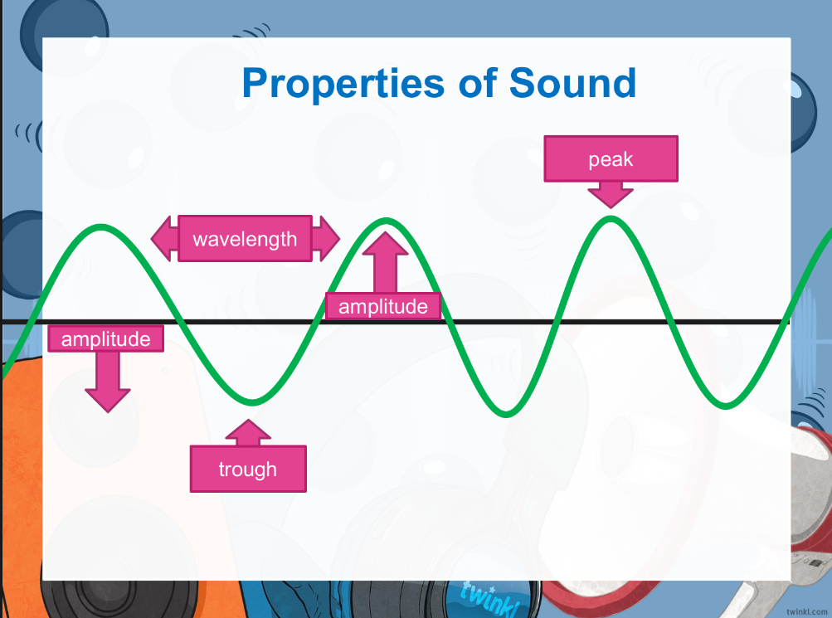
Add a Slide Title - 3

Slide 9
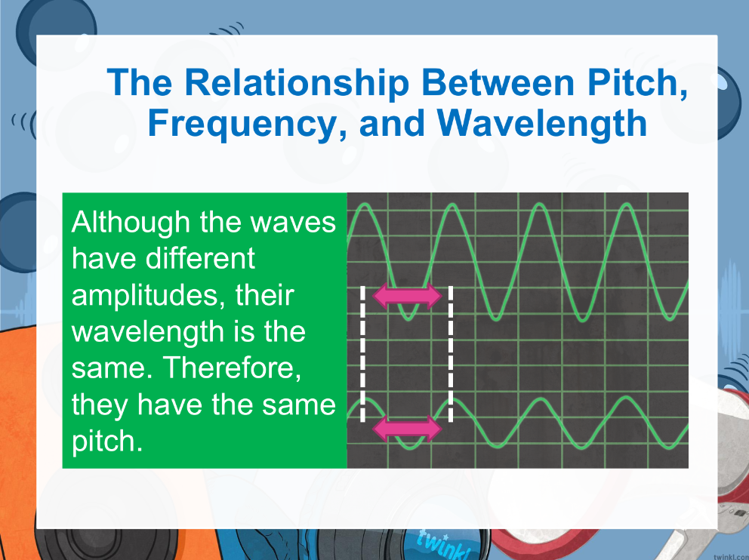

Slide 10
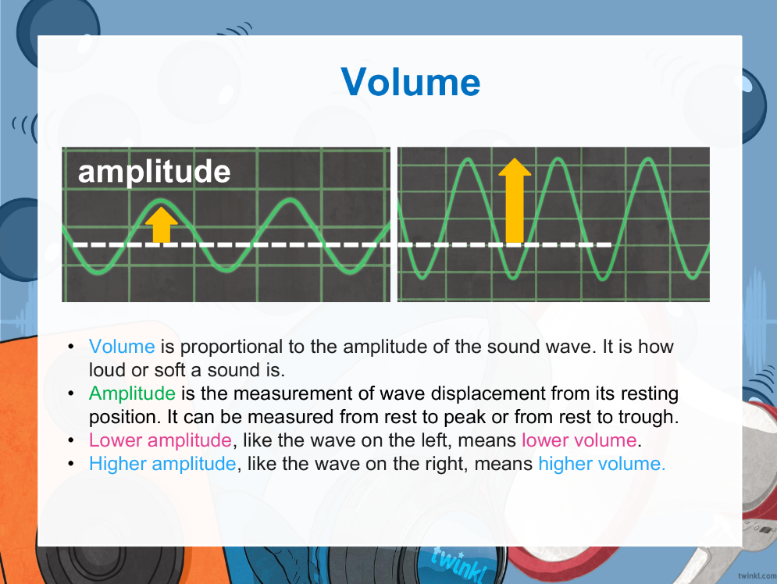
Add a Slide Title - 4

Slide 11
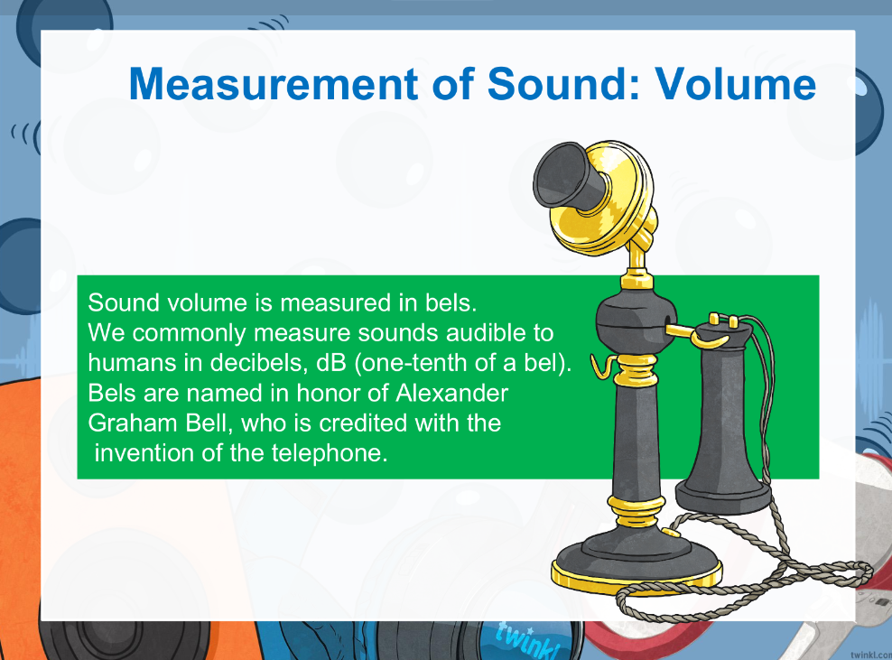
Add a Slide Title - 5

Slide 12
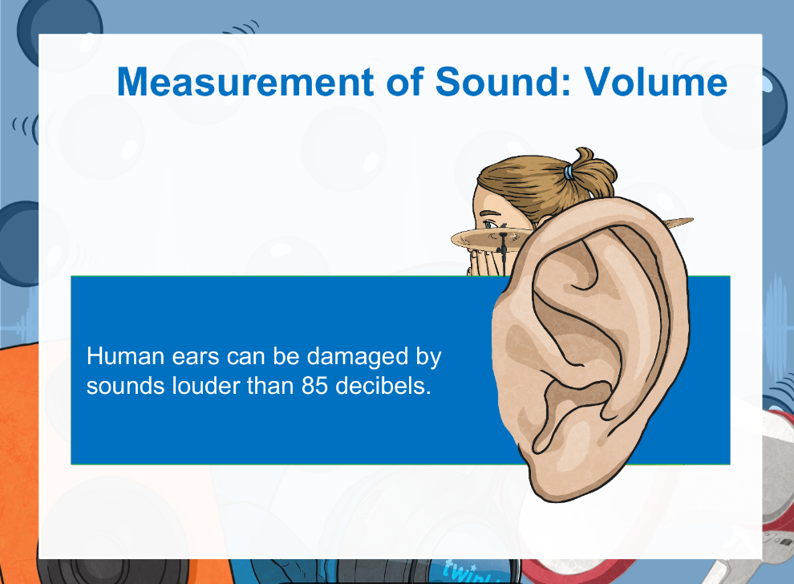
Add a Slide Title - 5

Slide 13
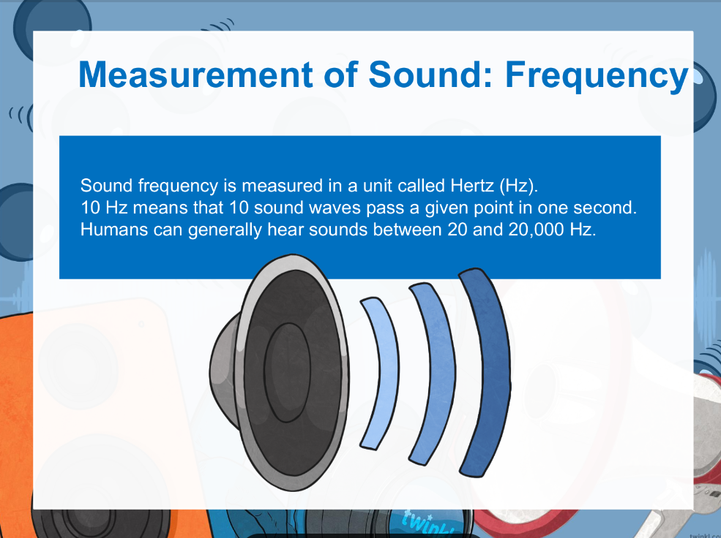
Add a Slide Title - 5

Slide 14
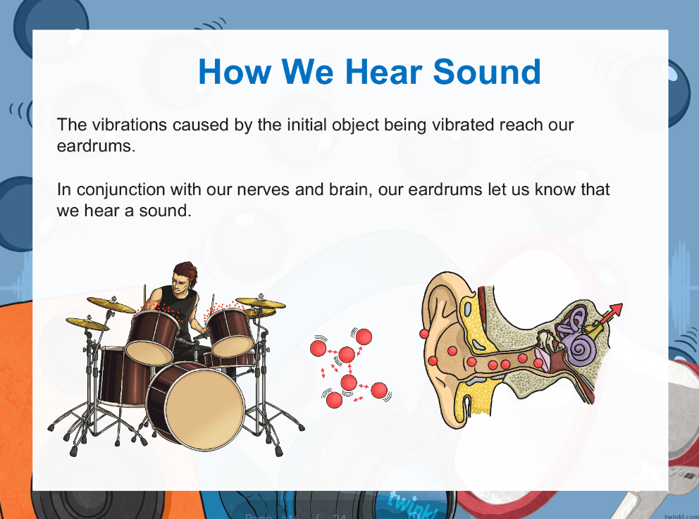
Add a Slide Title - 5

Slide 15
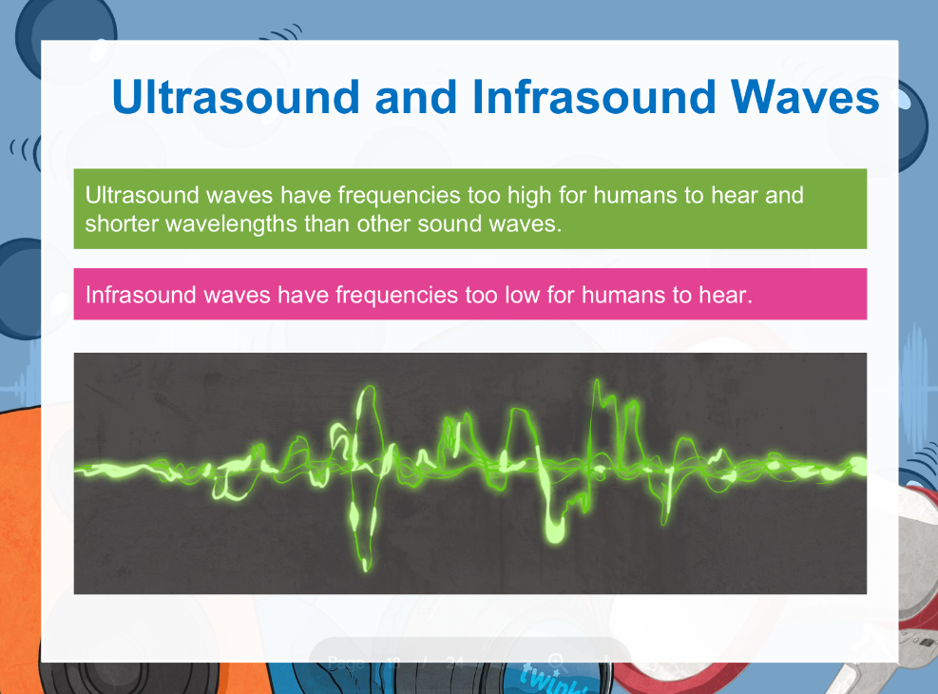
Add a Slide Title - 5

